Slide 1
Python Intermediate Tutorial – Flight Tracking
29th January, 2022

Slide 2

Introduction
McGill Mech Eng Grad 2021
Was part of MIAE, VFS, Rocket Team
Python:
Did a project during internship at Bombardier
Did a few courses and bootcamps on AI/ML and Data Science
Now a fullstack dev at a start up
My NY resolution is to read more, I started with 1984.

Slide 3
Agenda
Project Overview
Set up
Git – Theory and Application
API – Theory and Application
Data aggregation, analysis, visualization
Note: means we switch to coding for a bit.

Slide 4
Project Overview

Slide 5
Project Overview
Objective: The paper Impact of COVID-19 on worldwide aviation — traffic documentation (traffic-viz.github.io). The datasets Crowdsourced air traffic data from The OpenSky Network 2020 [CC-BY] | Zenodo.
What to know beforehand: basic PyCharm knowledge, basic Python knowledge. Not too much tbh.
Most important take-home messages: Maintainability, scalability, and reading and absorbing documentation. This is what makes a good programmer imo.
What is the outcome? Link above has pictures of graphs and results. We can also see some CSVs in our repo.

Slide 6
Set up

Slide 7
Set up
On PyCharm start a new project with venv and have your interpreter python version as >3.8
Show difference and usefulness of a venv (with pip example)

Slide 8
Git

Slide 9

Git and Github
Git: A tracking software! Used for version control
GitHub: Hosting software and very well integrated with Git.

Slide 10
Git and Github
Basic commands. Commit, add, branch, pull, push.
What’s a pull request?
Documentation page - GitHub Git Cheat Sheet - GitHub Cheatsheets
Additional useful things, like git-ignore, git-templates. Let’s look at PRs, branches, comments, and useful stuff on Github.
mowglu/MIAE-Python: An intermediate Python Tutorial with builder code on a separate branch. (github.com)

Slide 11
Git and Github
Onboarding time! The code will be boiler-plate. The intention is to code along with you with a known solution I have on hand. This can be released in sections actually and saved in different commits. Thus the boilerplate code can be **git pull origin ~commit_number** every few places I deem necessary.

Slide 12
API

Slide 13
API
What is an API? - application programming interface
Basics of API.
What is a RESTful API?
What is the difference between Python/Java/REST APIs?
Definitely show CTRL+SHIFT+I for any browser window
How will APIs be used for our project?
What are alternatives to APIs? (i.e. web-scrapping)
Web Scraping vs API: What’s the Difference? | ParseHub

Slide 14
API - continued
Show The Dream a bit with regards to Web scraping.
Could show cool information about Messenger (i.e. Facebook/META’s API). They have some really neat documentation. Can provide an example of how to view documentation for APIs and really get the important bits.
Will start an important part of the project here on Pycharm.

Slide 15
Data Stuff

Slide 16
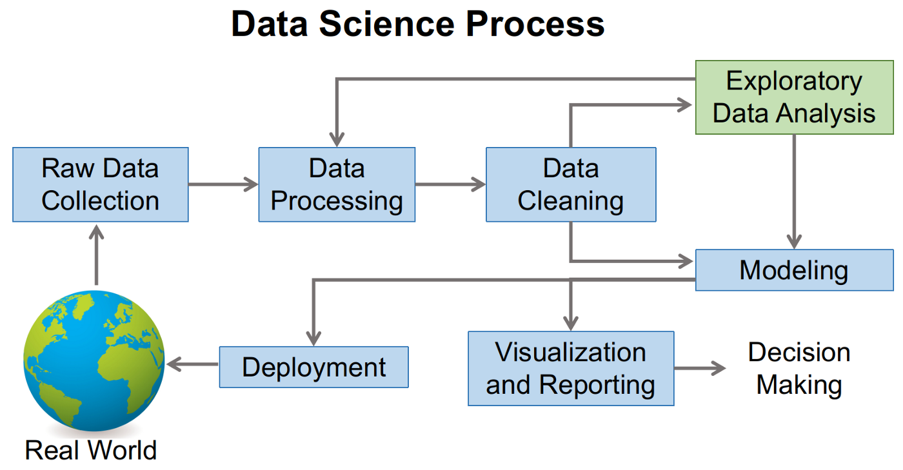
Data Stuff
Typical flowcharts of machine learning models. They typically have a LOT of data and they serve as best example of data flows.

Slide 17
Data Stuff - Continued
Google collab read-only link: https://colab.research.google.com/drive/1kx5J9f_HmjNWDnj76h4_Q4EL6deMArau?usp=sharing
Will switch to Google Collab now for coding and moving the code back to Python!

